Slide 1
Problem session prep - 2
Natalie Nelson, PhD, Biological and Agricultural Engineering
BAE 495/590: Applied Statistics for Env. & Ag. Data Analysis
January 26, 2018

Slide 2
Clarification of points from data visualization lecture
ggplot2
Continuous vs. discrete data

Slide 3
Considerations to make when using color ramps
Equal changes on ramp ≠ equal changes in value
Using a 10% - 90% black avoids this issue
Wong (2011), Nature Methods
Notes:
(a) Shifts in color scales (circles) are not visually commensurate with change in value. Reprinted from Nature Methods2, 5. (b) A gradation from 10–90% black produces even transitions.

Slide 4
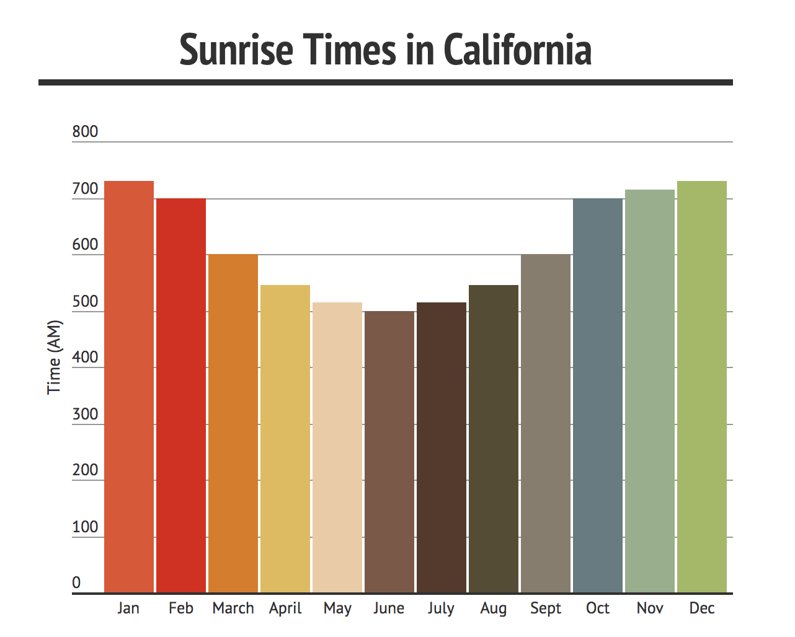

Slide 5
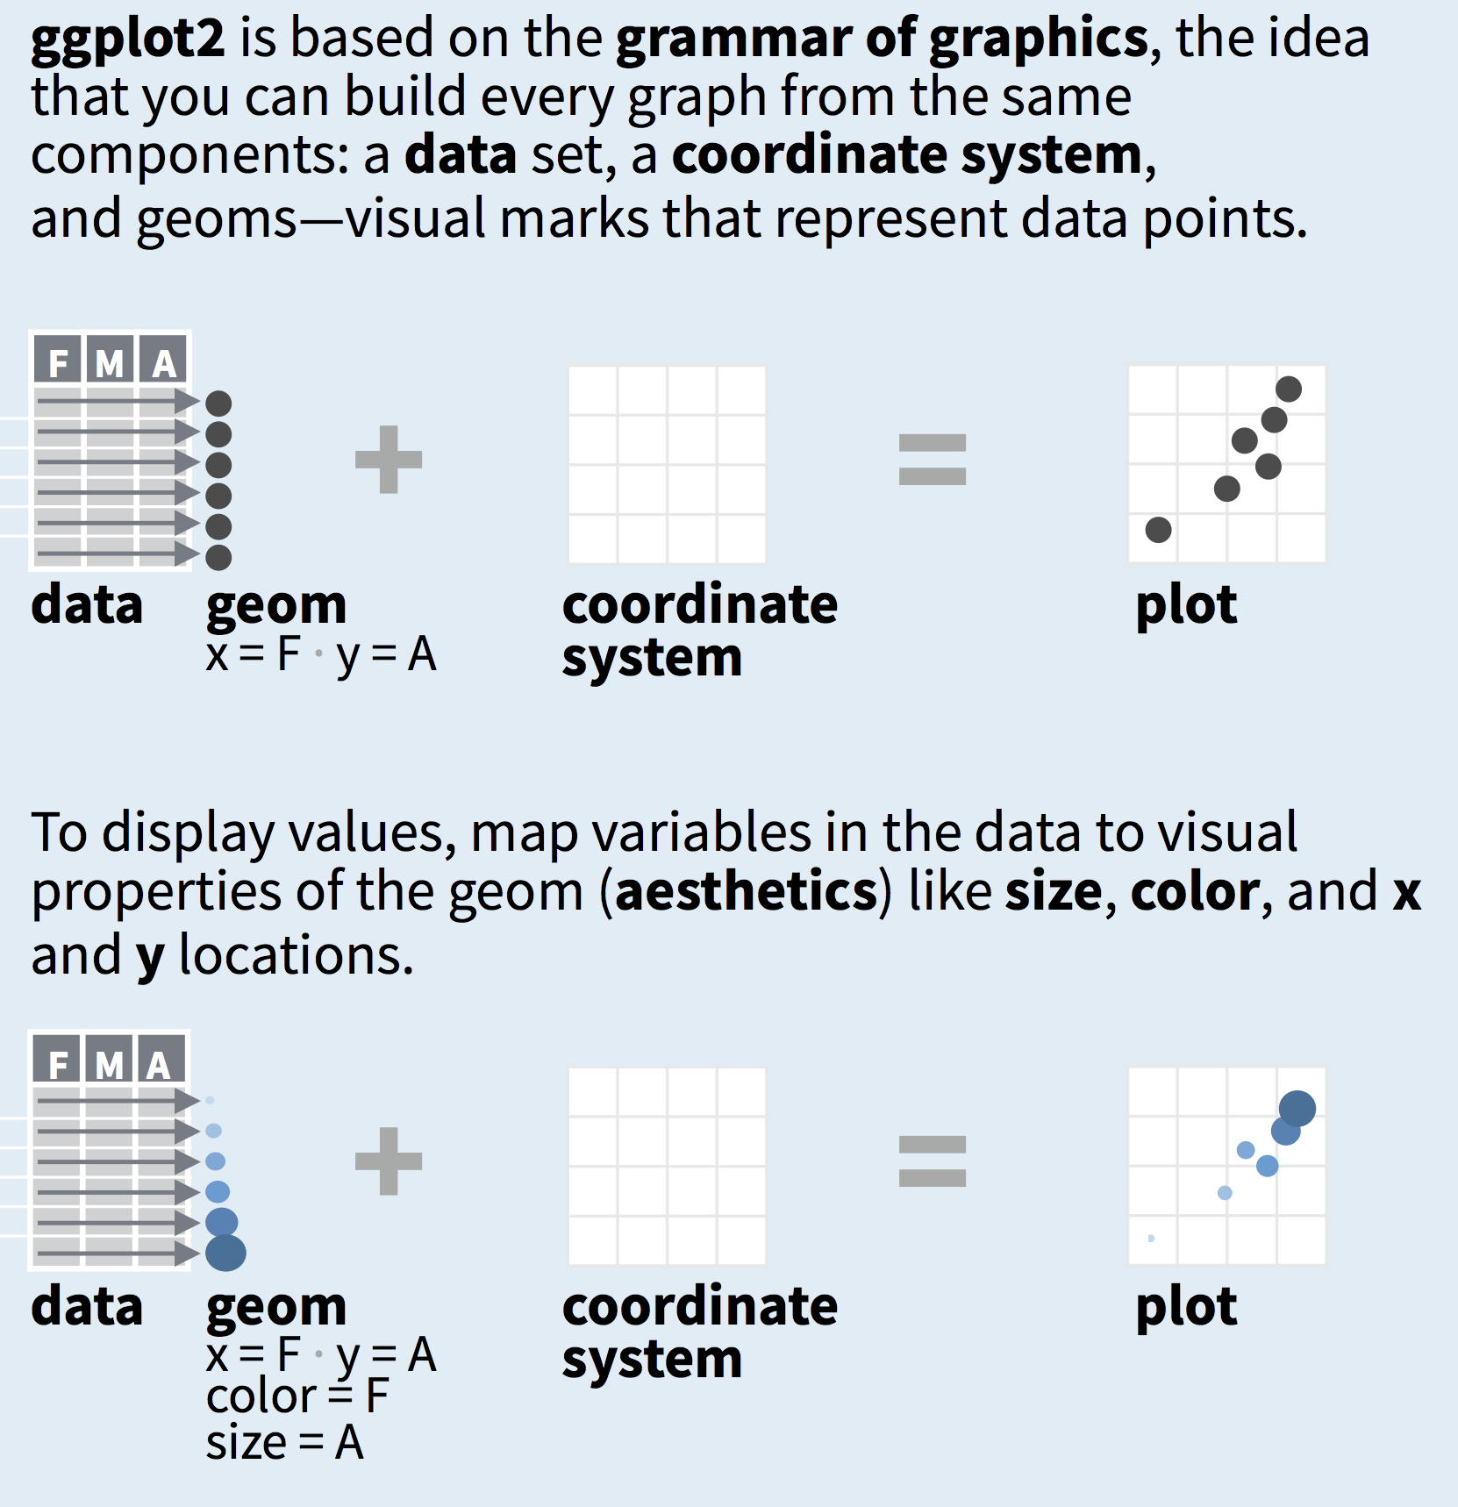
ggplot2
Leading data visualization package in R
RStudio Data Visualization Cheat Sheet

Slide 6
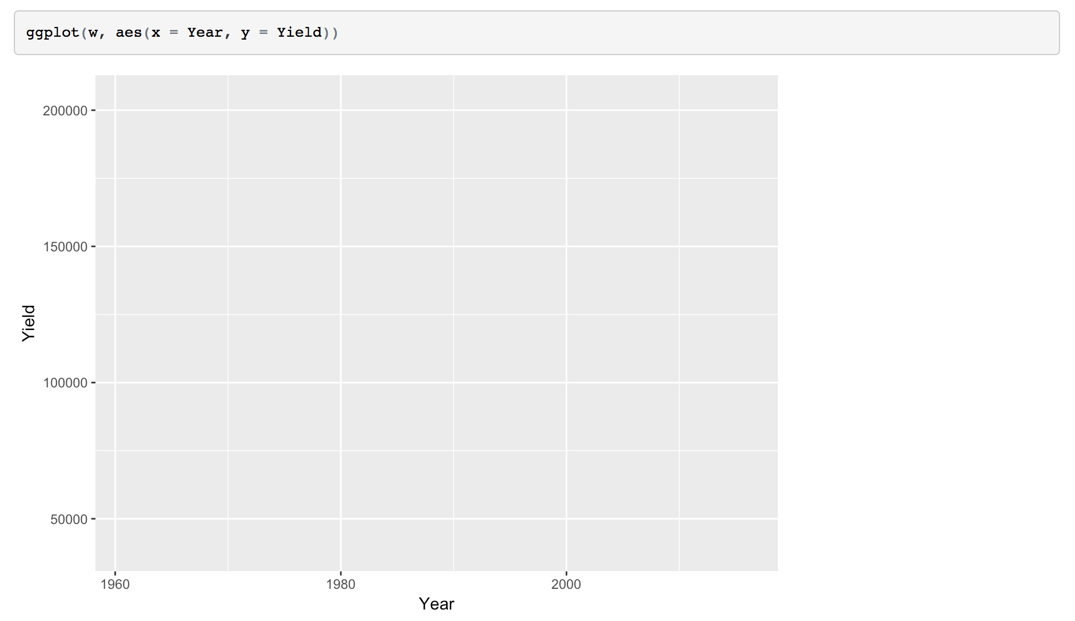
ggplot(d, aes(x = , y = ))
ggplot() calls your base plot
aes() stands for aesthetics – this is how you tell your function how your variables should be mapped to your visualization

Slide 7
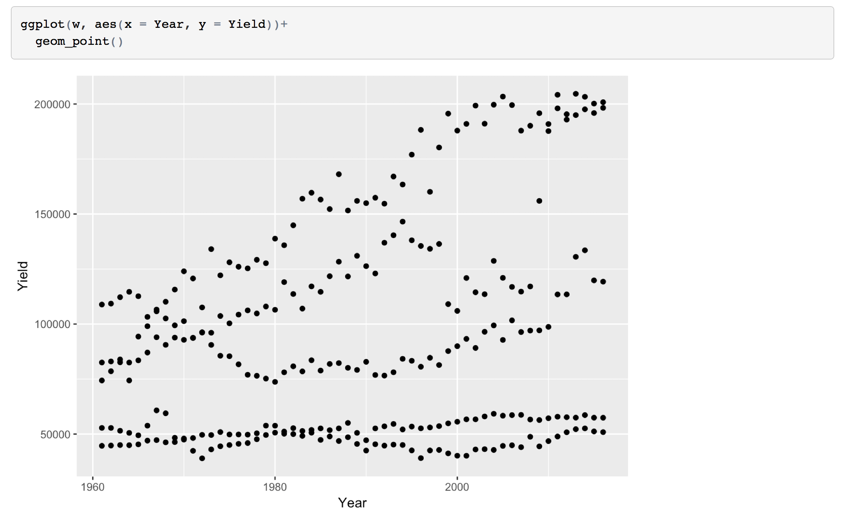
ggplot(d, aes(x = , y = ))+
geom_[style]( )
geom functions tell ggplot which visualization style to use

Slide 8
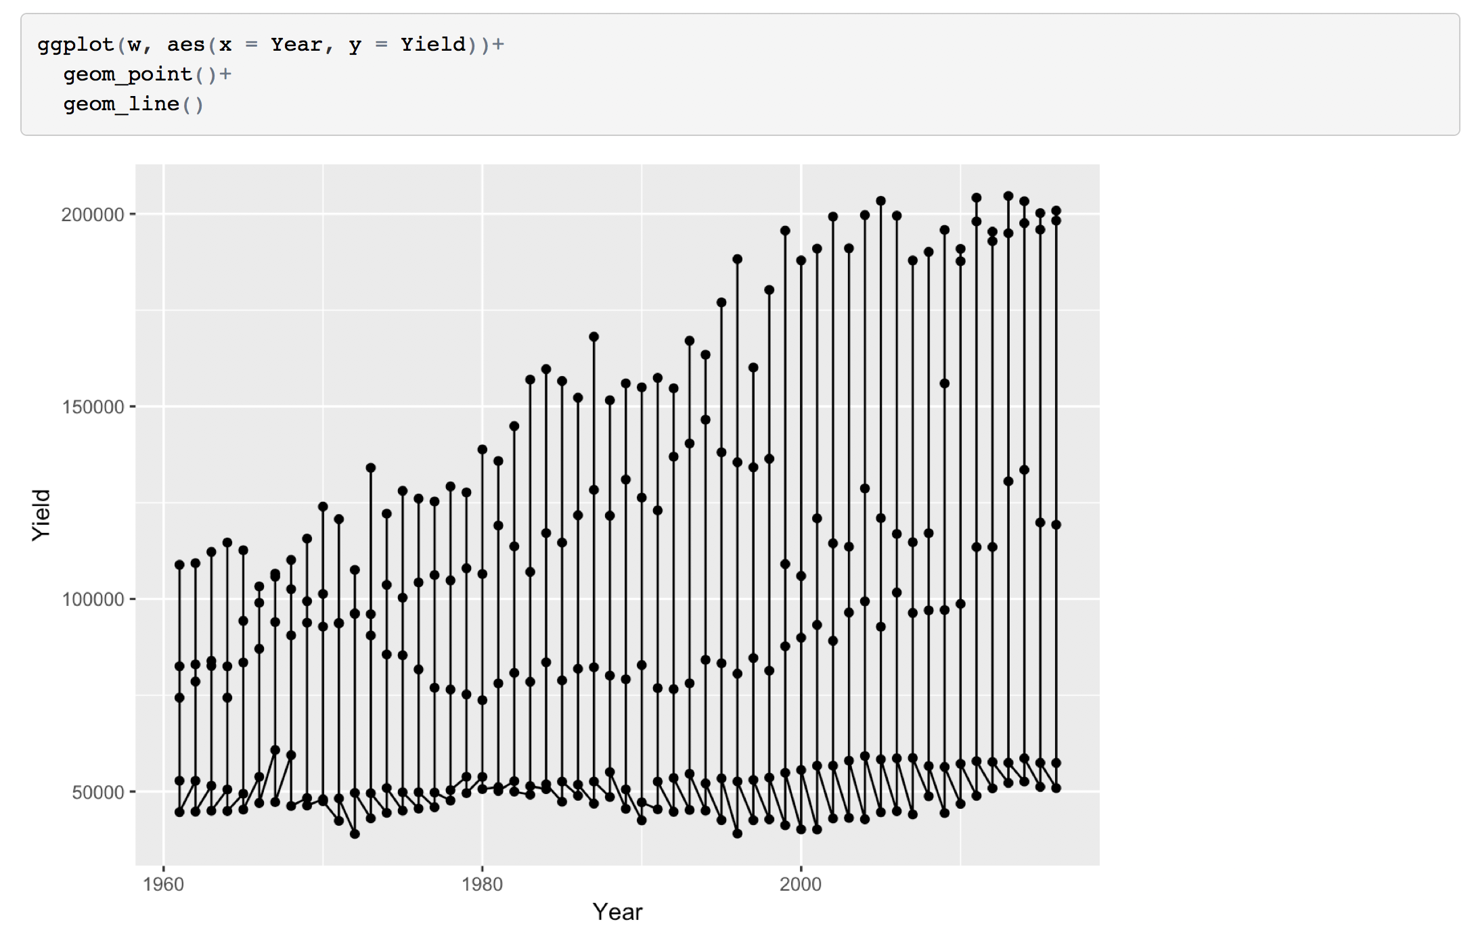
ggplot(d, aes(x = , y = ))+
geom_[style]( )+
geom_[style]( )+
geom functions are added to create visualization layers

Slide 9
Discrete vs. continuous data
Discrete – finite set of values; data can only take certain values. In R, this includes qualitative data (i.e., factor data).
Factors can be thought of as categorical data
Continuous – infinite set of values; data can take any value in a given range. In R, these are typically numeric or integer data.
Images from UX Magazine

Slide 10
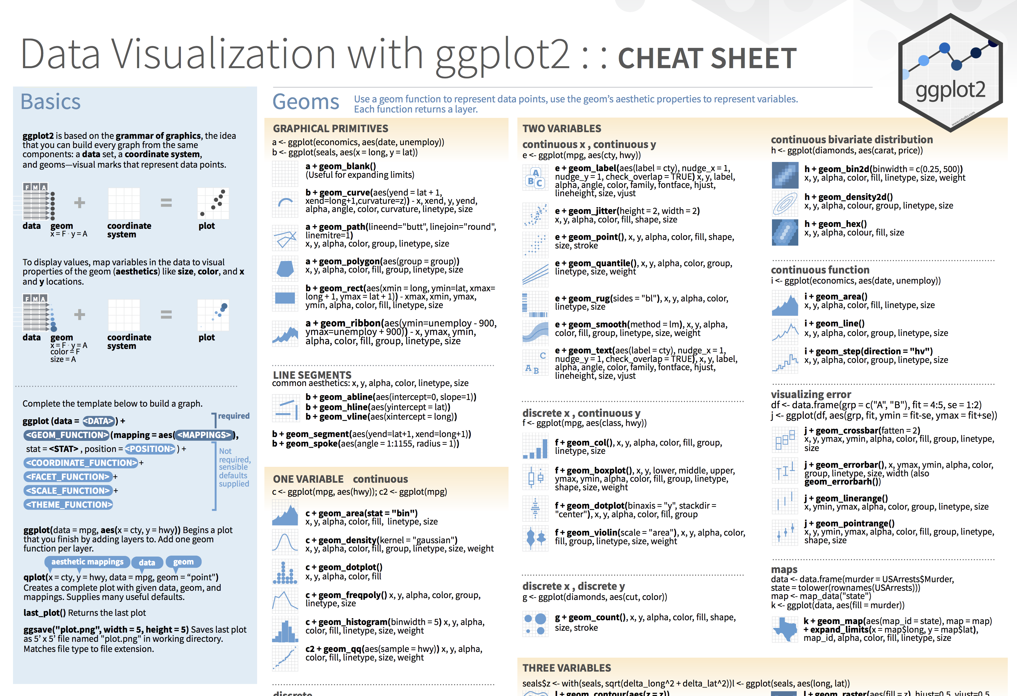
Let’s look at the Cheat Sheet
Available at: https://www.rstudio.com/resources/cheatsheets/

